Slide 2


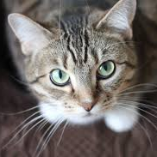
root
labs
hws
plans
resume.txt
607 B
cat.jpg
607 B
evil
lab1.txt
223 B
lab2.txt
251 B
lab3.txt
317 B
vacation.txt
636 B
world_domination.txt
766 B

Slide 3
user
bob
bagels.txt
hw8
notes.txt
lec21.py
hw8.py

